Slide 1

Section 6
Documents and Clustering

Slide 2
Bag of Words
Treat words equally, output most common words as most important
Advantages:
Easy to describe
Fast to compute
Weaknesses:
Common words dominate counts
Uncommon words tend to define a document
Notes:
what we really talked about in class was document retrieval - ways to gather information from a document and test similarity, etc.
so we talked about this notion of embeddings and how to represent documents in two different ways
first way- BoW
idea: find every word in a clustering of sentences or in a document and then indicate how many times that word appears in that document or sentence
pros and cons: pretty intuitive and easy way to categorie our words however often times common words like the or and dominate our word counts and most of the time we find that uncommon words can probably better define our document

Slide 3
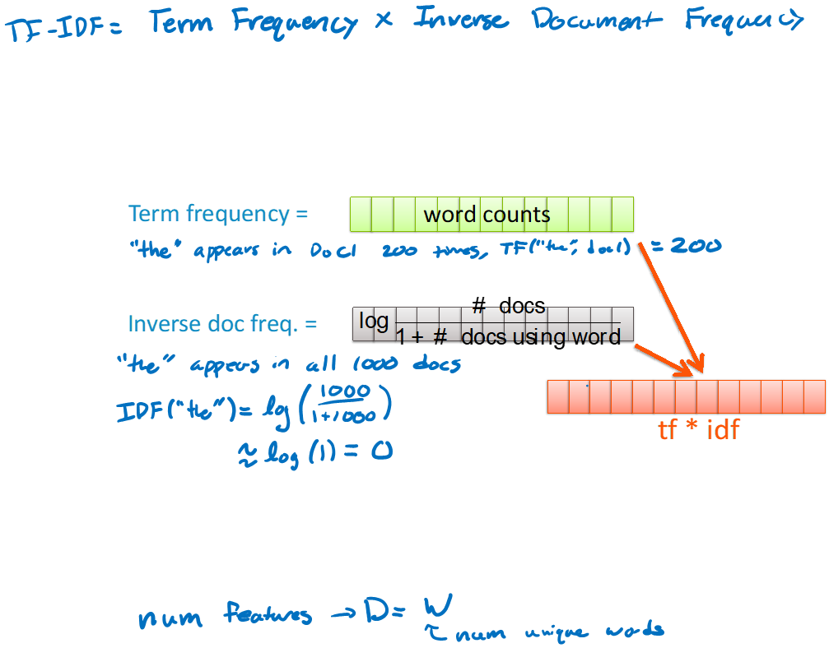
Term Frequency Inverse-Document Frequency
Emphasizes important words
Term Frequency: how common are words in a single document
Inverse Document Frequency: how common are words across the collection (corpus) of documents
Pairwise multiplication to find TF-IDF of each word
Notes:
and so this leads us to discuss another way of categorizing a document known as tf-idf
and this basically multiplies how common a word is in a single document with the inverse document frequency which how common a word is across the collection of documents
and so you can see we calculate these by getting the word count and also taking the log of #docs / 1 + #words using the doc
this method is used to emphasize important words and its a pretty common technique and if you’ve taken 163 or 373 you’ve probably implemented a word search thing using this method

Slide 4
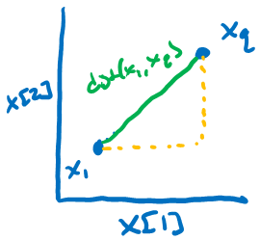

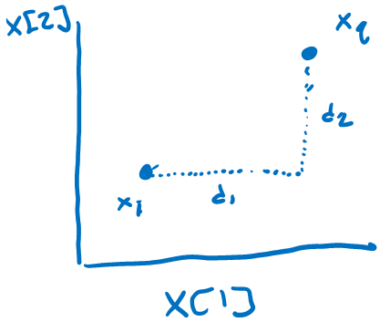

Euclidean vs Manhattan Distance
Euclidean Distance
Simple to define
Manhattan Distance
Orthogonal paths
Notes:
so now we are going to talk about distance and the main motivation behind this is comparing different documents together and how to determine if two documents are close or not
so the first two ways we talk about are euclidean and manhattan, these are fairly simple
so the euclidean distance is subtracting two points from each other squaring it and summing it up then taking the sqr root of that and it gives you like the hypotunuse
and the manhattan distance is finding orthogonal paths- perpendicular paths to find the distance between two points so to do this

Slide 5
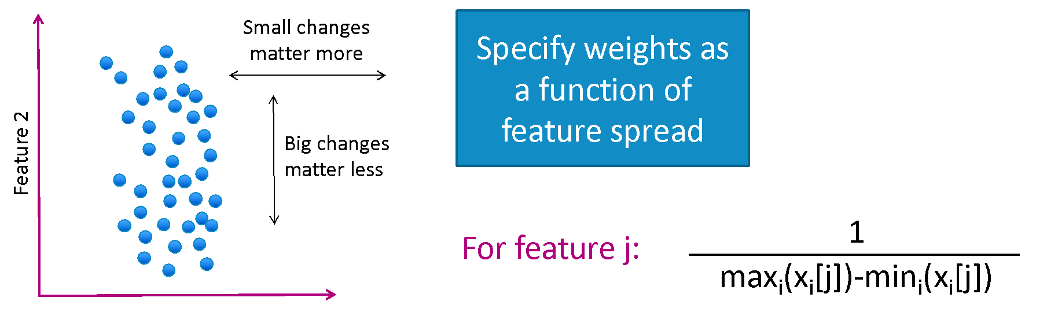

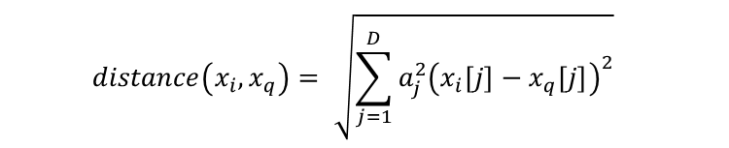
Weighted Distance
Some features vary more than others or are measured in different ways
Weighing dimensions makes distance metric more reasonable
Weighted Euclidean Distance
Notes:
additionally we have weighted distance and this is basically very similar to euclidean distance but your values, or words in our case have specific weights which indicate how important that word is and so the way i guess we talked about finding that weight would just be doing 1/max-min -- however one thing to note is that there are actually many ways to find a weight besides this method this is just kind of what we talked about- and so one thing that’s cool about this is that is you don’t have to normalize before you calculate distance bc you are essentially normalizing your points as you go

Slide 6
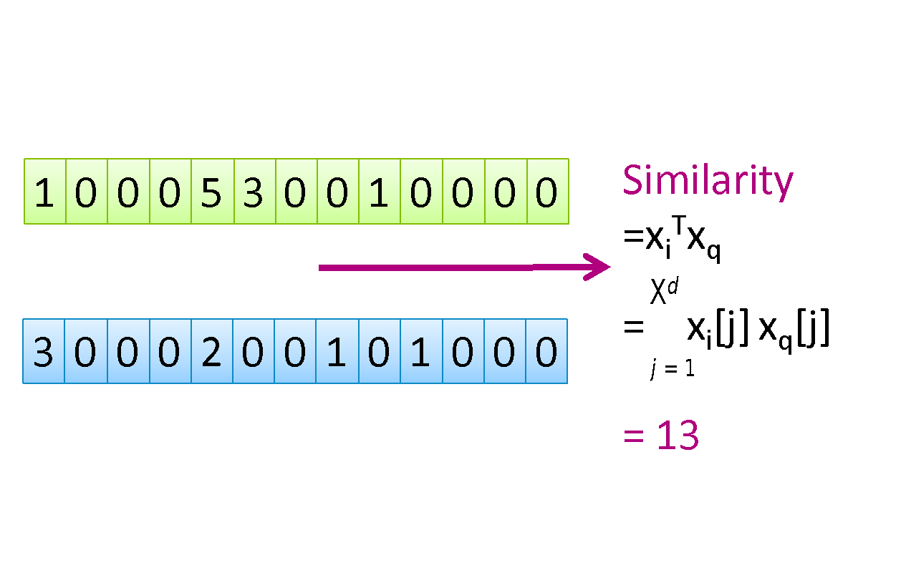
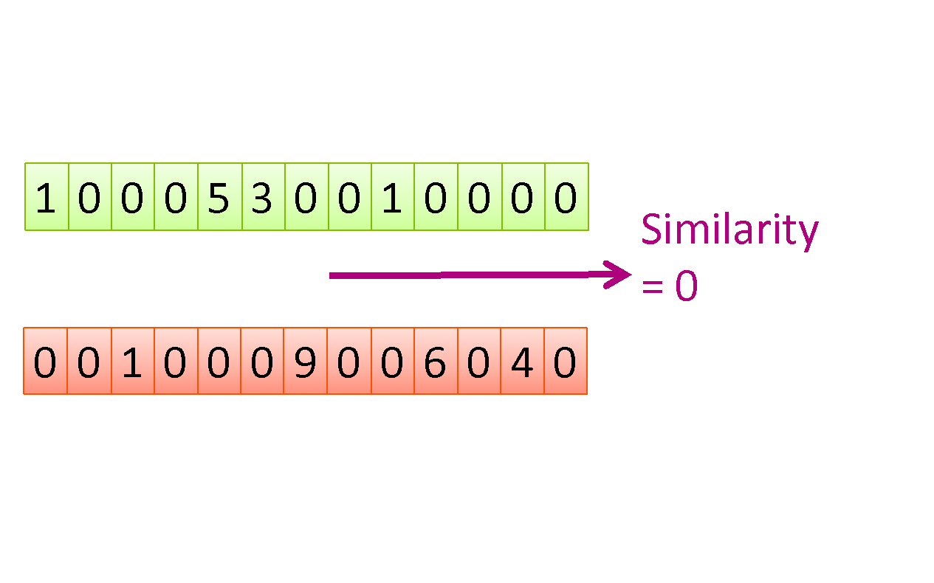
Similarity
Unlike Distance, a greater Similarity is better for recommendation
Notes:
so the next comparison method we talked about is similarity, so unlike
distance similarity is great for recommendations since it is just finding the amount of words similar among two different documents
and so this is pretty good when comparing two pairs of documents that have the same length but if we compare two documents that is way smaller than another two documents we are looking at we might want something to account for that difference so it’s not like we are comparing apples to oranges in a sense

Slide 7
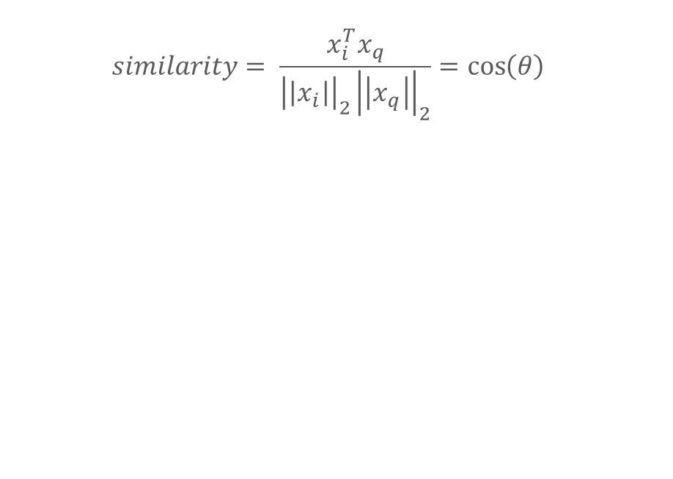
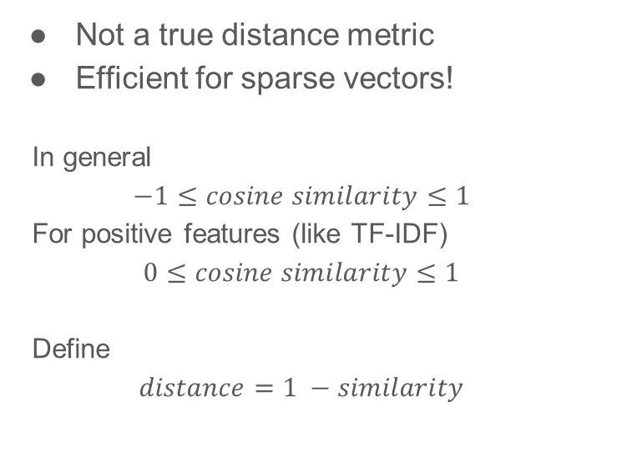
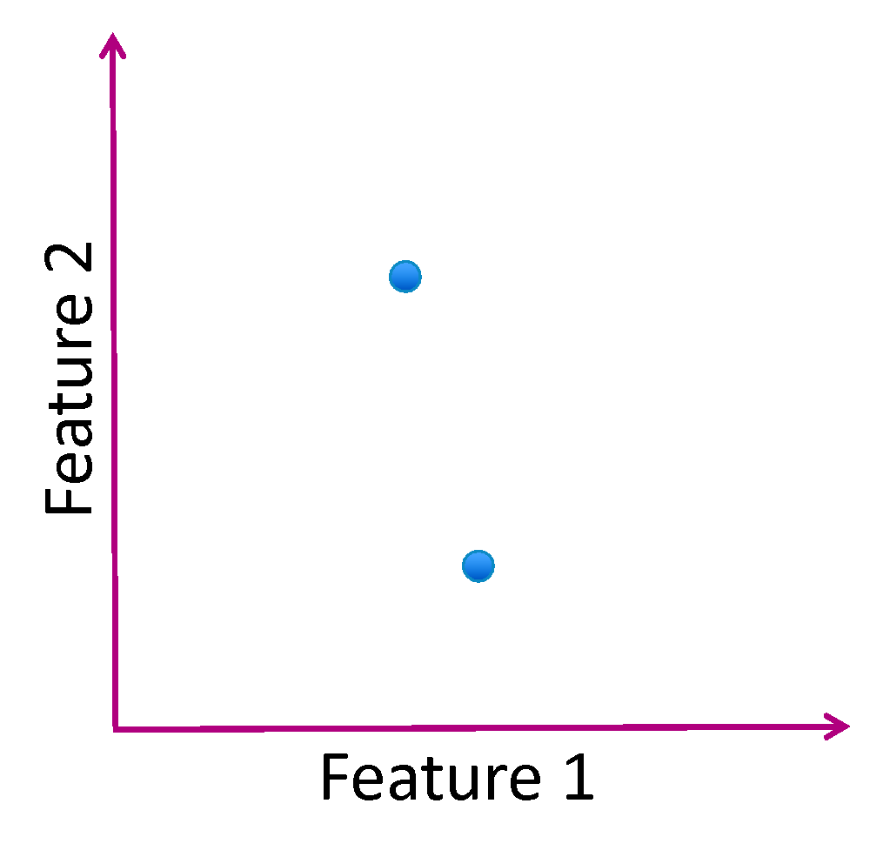
Cosine Similarity
Notes:
so that kind of leads us to cosine similarity which in a way normalizes our findings in a way
so when comparing two documents, you use this similarity formula to find the angle between these two documents so the closer the angle the more similar two documents are so then if you compare like pairs of documents against each other, it’ll actually be comparable

Slide 8
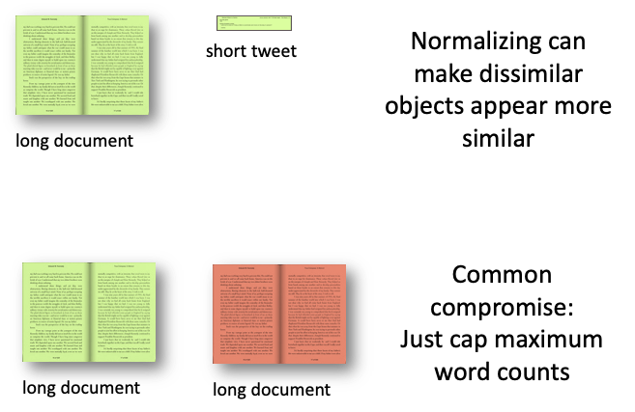
Normalizing
Normalization is not desired when comparing documents of different sizes since it ignores length.
In practice, can use multiple distance metrics and combine them using some defined weights
Alternately, don’t normalize, but cap max number of words
Notes:
and so now to briefly touch on normalizing, this is desired when we are comparing pairs of documents against each other, not when we are comparing two documents against each other, i hope that made sense- so like you can see we don’t want to normalize when comparing a long document and a short tweet because it would make our documents appear more similar even though they might not be super similar we want to do it because when we are comparing pairs of documents against each other it allows those pairs to be comparable-- and often times instead of normalizing you can set a max word count as a compromise like tweets for example have max word counts and that can make it so that all those documents are easily able to be compared

Slide 9
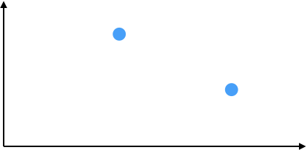
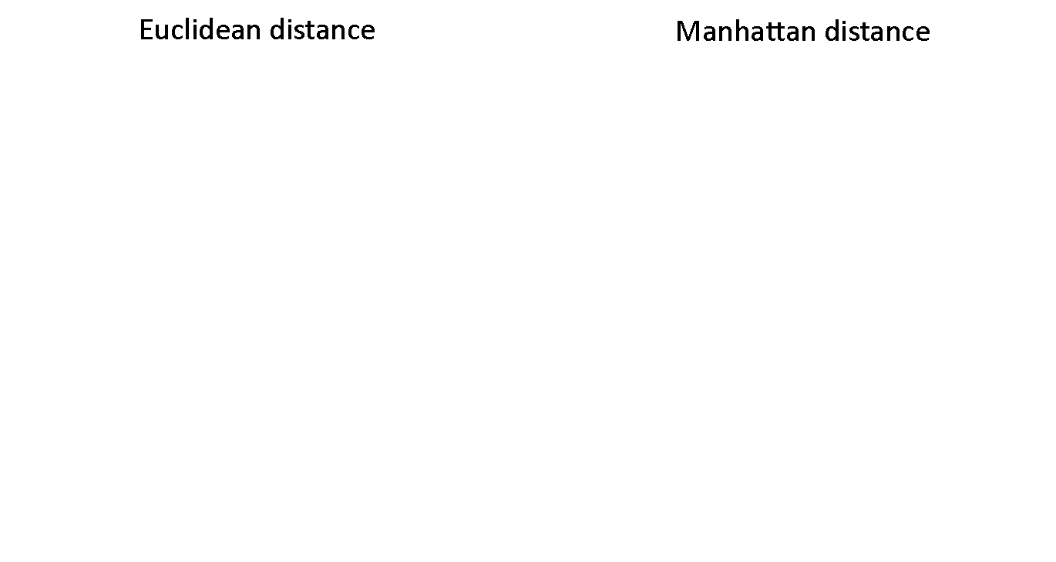


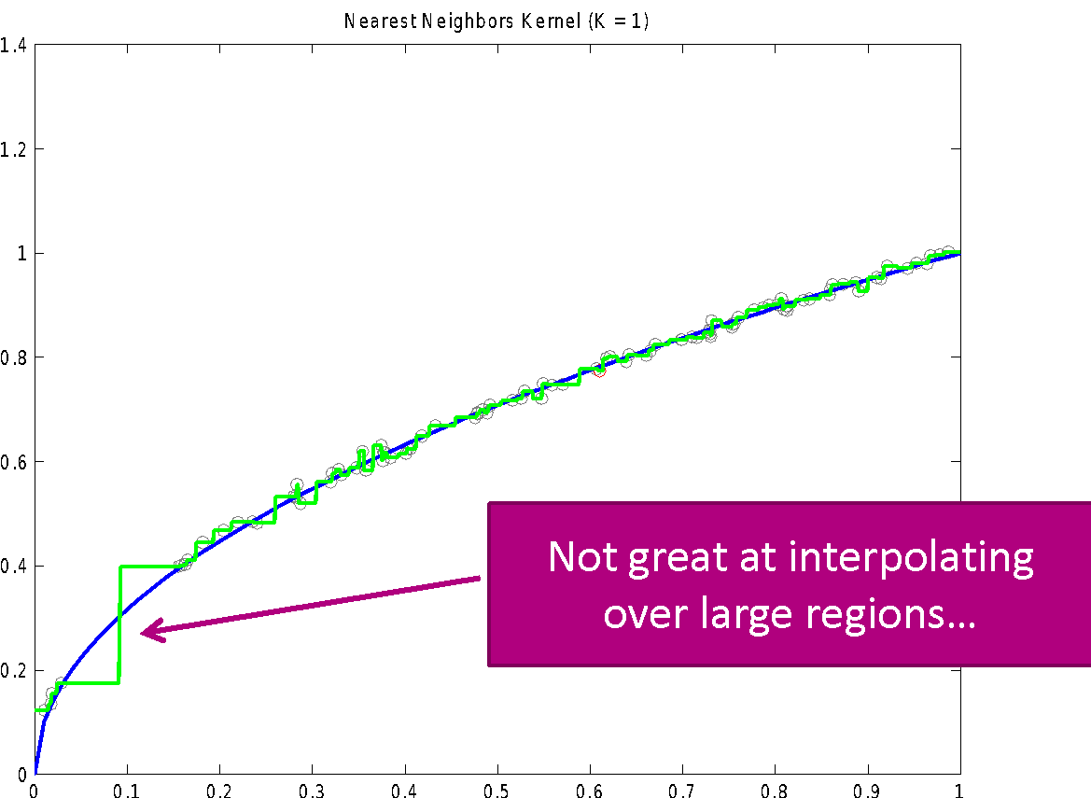

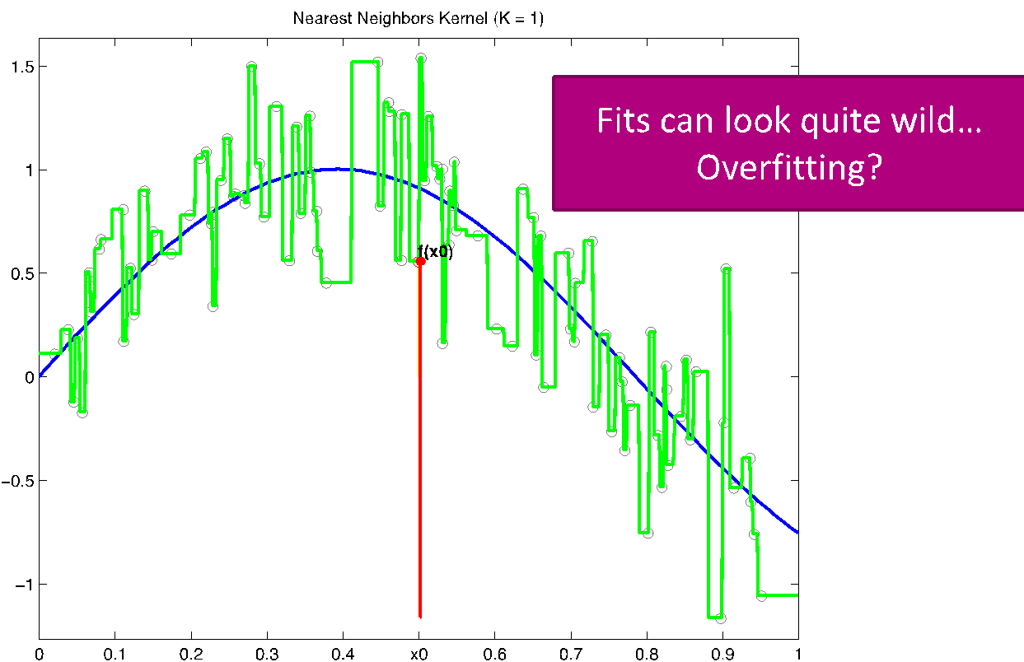
Nearest Neighbor
Visualizing with Voronoi Tessellation
Definitions of “closest”
Euclidean distance
Manhattan distance
Weaknesses:
Weaker with sparse data
Potential to overfit
O(n) complexity with n data points
Notes:
ok now we’ll talk about nearest neighbor and to remember the context we talk about this in so if we have a bunch documents, say we want to find the most similar document to it, we could try to find it’s nearest neighbor, like you can think of book recommendations or something as a real world application to this-- and so what we’ve covered so far is we had documents, we created an embedding such as BOW or TFIDF and then used distance or similarity metrics to determine the closeness of our documents-- now what we need to do is actually find which document is the closest and so that’s where nearest neighbor comes into play
and so the first variation of nearest neighbor we looked at is just finding one nearest neighbor, so for the thing we are trying to predict we would find that point that is closest to it and say for all things that are in this category we will predict this point- there are some weaknesses to that like if you don’t have muc data it won’t be as helpful, there’s a potential of overfitting, as well as taking a while to compute

Slide 10
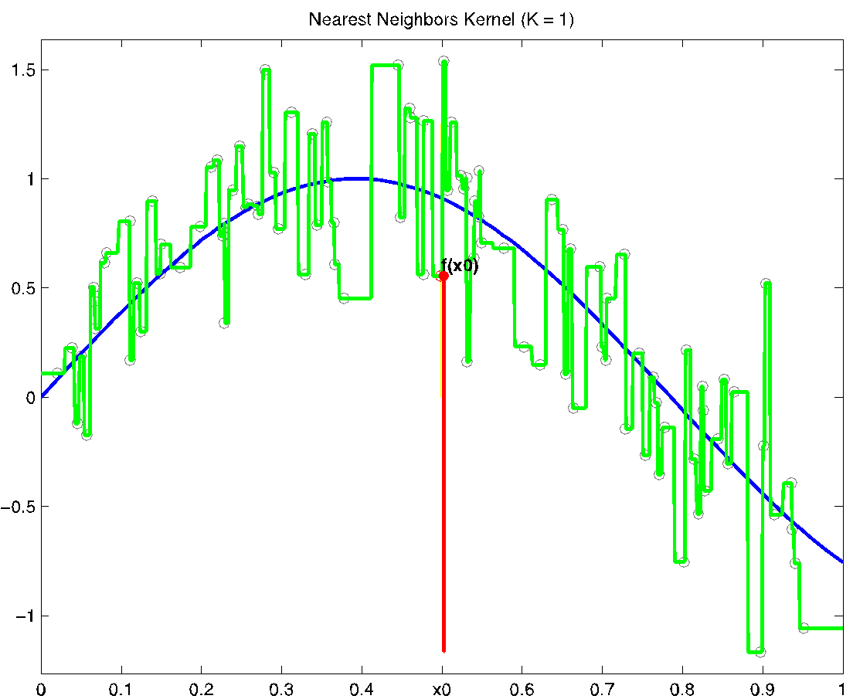
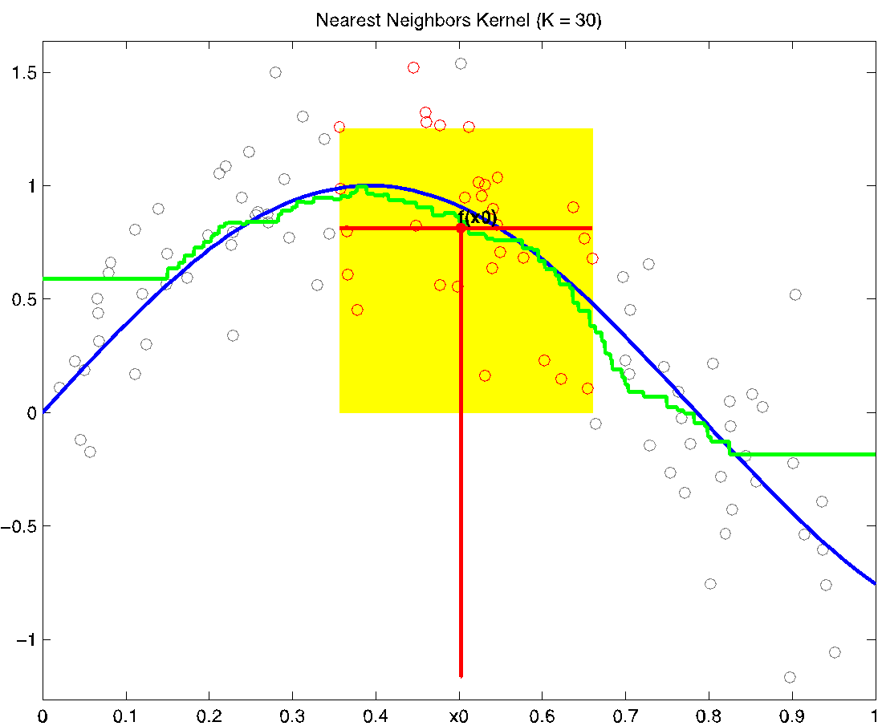
K Nearest Neighbor
Look at more than one neighbor, average result
Advantages:
More neighbors make the function better behaved
Weaknesses:
Still includes discontinuities (discrete decision to include/exclude)
Choose k carefully
Notes:
this is very similar to one near neighbor but now you are looking at a range of k values for a specific point and average the results for your plot
advantages and disadvantages

Slide 11
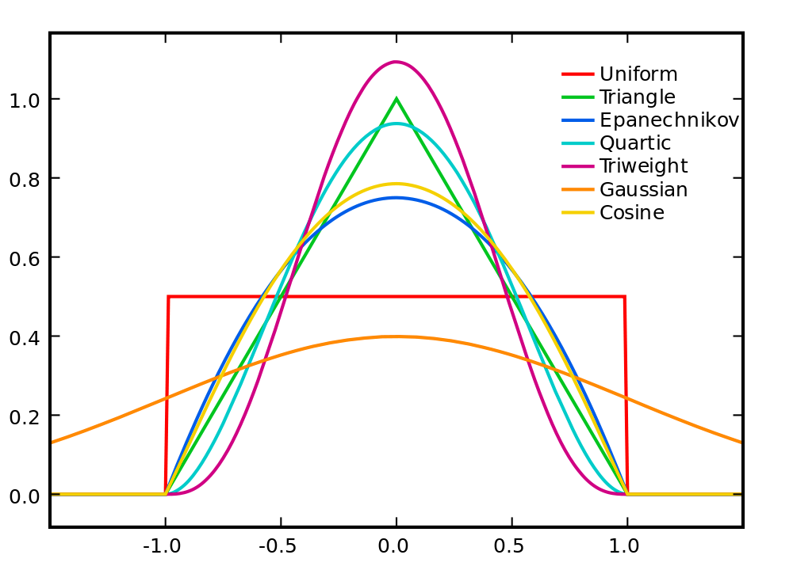

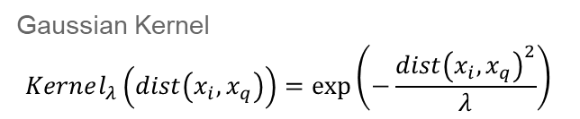
Weighted K Nearest Neighbor
Weigh the closer neighbors more (they are more similar)
“Kernel”: function transforming distance into weight
Popular kernels:
Uniform/boxcar
Gaussian
Epanechnikov
Different kernels generally give identical learned functions
Most kernels parameterized (how many points to look at), and emphasize low distance over far distance
Notes:
then we have weighted k nearest neighbors so the neighbors closer to your points will be weighted more and to do this weight you’ll use something called a kernel and then you’ll average those points out and the main things that you need to know about kernels is that they are parameterized and use this parameter called lambda that is a bandwidth so if you have a big lambda you are giving weights to more points but if you have a small lambda you are giving weights to less points
additionally the only kernel you need to keep in mind for this class is the uniform/boxcar kernel which essentially gives the same weights to all your points within lambda

Slide 12
Approximate Nearest Neighbor
Deals with runtime weakness by finding a “close enough” nearest neighbor rather than exact nearest neighbor
Locality Sensitive Hashing (LSH)
Yields a close neighbor with high probability
Want some probability of success
Notes:
so one thing you know about nearest neighbors is that it takes a while to run, so in order to speed up the process we will try to find a nearest neighbor that is close enough - and this is just kind of a tradeoff that maybe you wanna do bc of certain things you value in your model

Slide 13
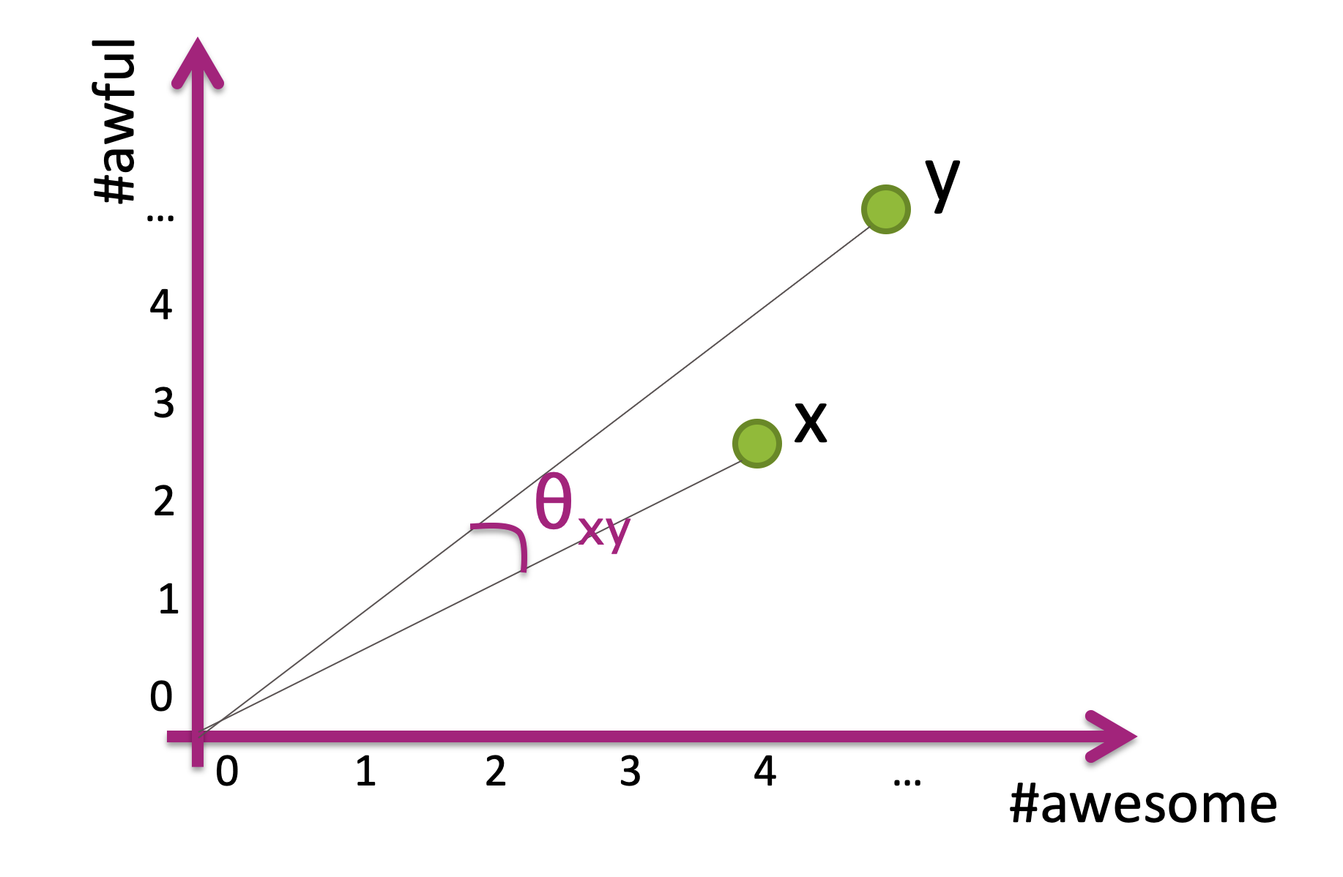
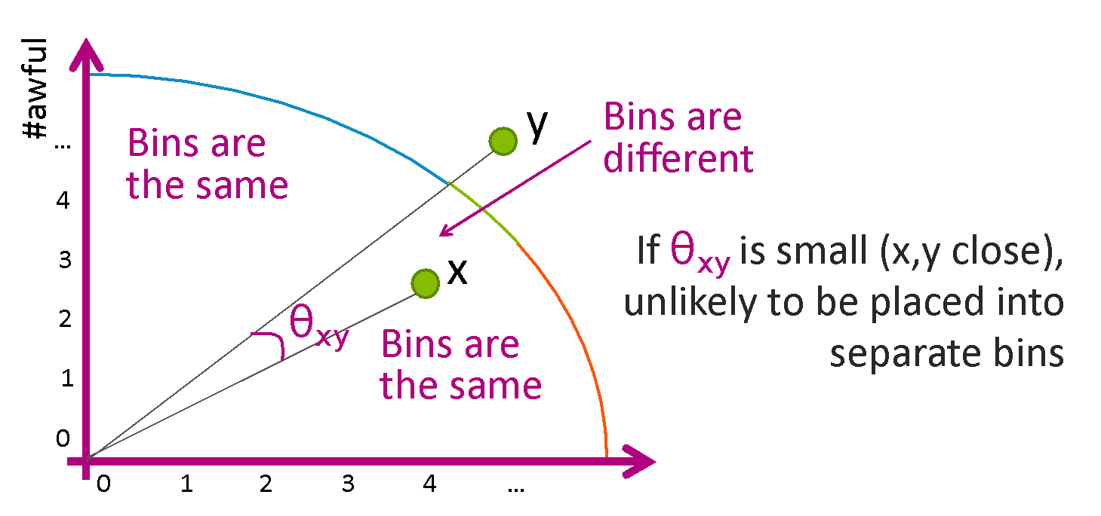
Locality Sensitive Hashing
Idea:
Break data into smaller bins based on proximity
Find exact nearest neighbor within a bin
Tradeoffs:
More bins -> Fewer points per bin -> faster search, and also a given bin may not have the true closest neighbor if it is a small bin
Notes:
and so to this we’ll use this thing called Locality Snesitive Hashing where we break our data into bins based on how close our points are to eachother and we choose the bin that our point land in and do a nearest neighbor search within that bin
there are a couple of tradeoffs to thing about though such as having more bin might be a faster search but maybe you won’t get the closest value but have less bins maybe more costly but you will find a pretty good nearest neighbor so it’s just a spectrum

Slide 14
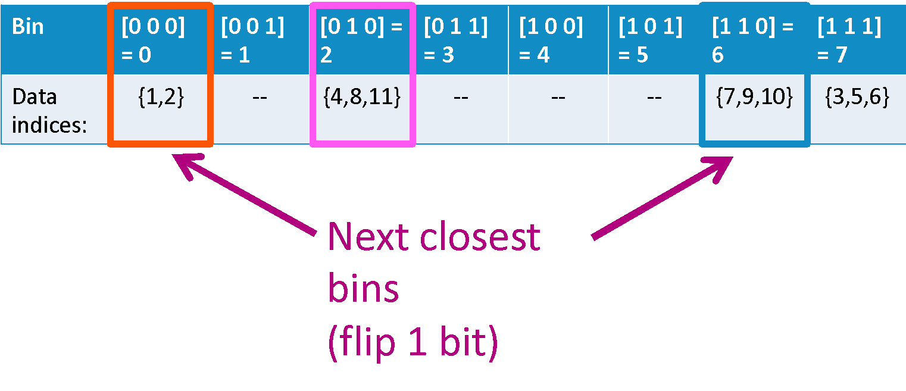
Binning
Use a line to separate the data and sort the groups on either side of line into bins
A random line works fairly well
Points with close cosine distance tend to be in same bins
Close bin indices differ by one bit
Notes:
and then some quick notes on binning, so using a random line works pretty well, if you have a lot of bins your bins will most likely only differ by one and also based on how much time and space you have you might even search multiple bins in order to be more accurate so again this just goes along with different tradeoffs you might think about

Slide 15
Clustering
Unsupervised learning (no labels)
Uses embeddings and distance
Embedding: Turning data into a vector of continuous numbers
Distance: Metric of separation between data points
Group data points into discrete clusters based on distance metric

Slide 16
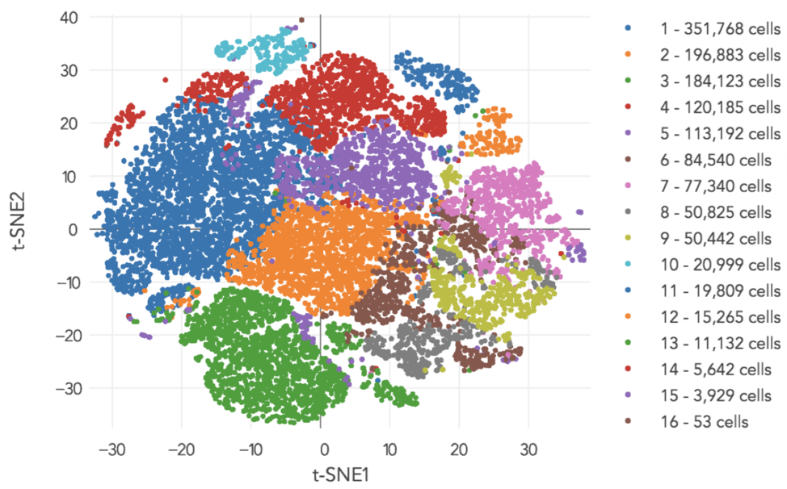
Clustering Example
Clustering human cells based on gene expression data
Source: link to source

Slide 17
K-Means Clustering
Clustering algorithm idea:
Divide the data into groups
Check how good our solution is
Algorithm
Assign each data point to the closest centroid
Move each centroid to the mean position of the data assigned to it
Repeat until condition met
No significant change in assignments
Max number of iterations reached

Slide 18
Initializing Centroids
Random initialization
Fast and easy
May get stuck in globally-poor local optimum
Probabilistic placement
Idea: centroids may be anywhere, weigh the possible locations by inverse distance to other centroids
A close to B is unlikely, A far from B is more likely
More calculation intensive
Less likely to divide the same “ground truth” cluster as two clusters

Slide 19
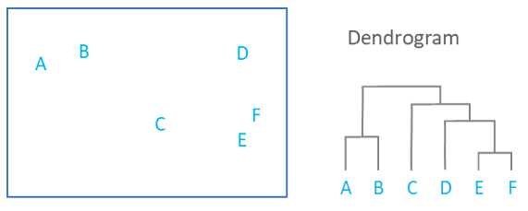
Hierarchical Clustering
Spherical clusters may not accurately describe data
Assuming hierarchies, learn more flexible cluster shapes
Agglomerative: link small clusters together (“bottom-up”)
Divisive: split large clusters (“top-down”
Is the assumption valid?
Features
Instead of choosing k, see the stages of clustering, and choose a reasonable one afterwards
Different distance metrics possible, beyond Euclidean distance

Slide 20
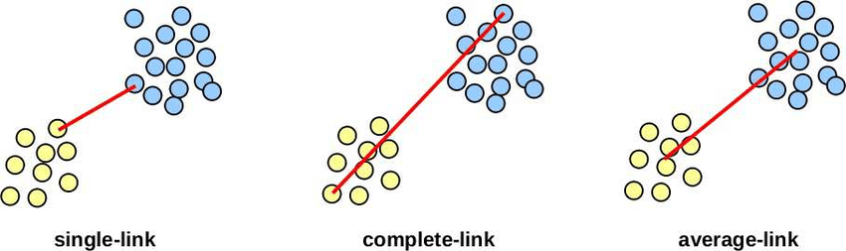
Agglomerative Clustering
Initially, each data point is a cluster
Iteratively combine two closest clusters into one
Possible distance metrics
Single linkage: minimum distance between points in the two clusters
Complete linkage: maximum distance between points in the two clusters
Centroid linkage: Distance between mean points in the two clusters

Slide 21
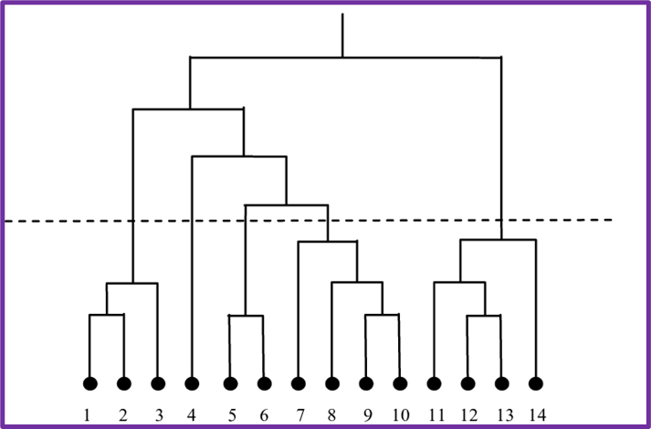
Agglomerative Dendrogram
Build up a dendrogram representing the order of cluster combination
Determine the number of clusters, “cut” the dendrogram to see which clusters points belong to
Five clusters

Slide 22
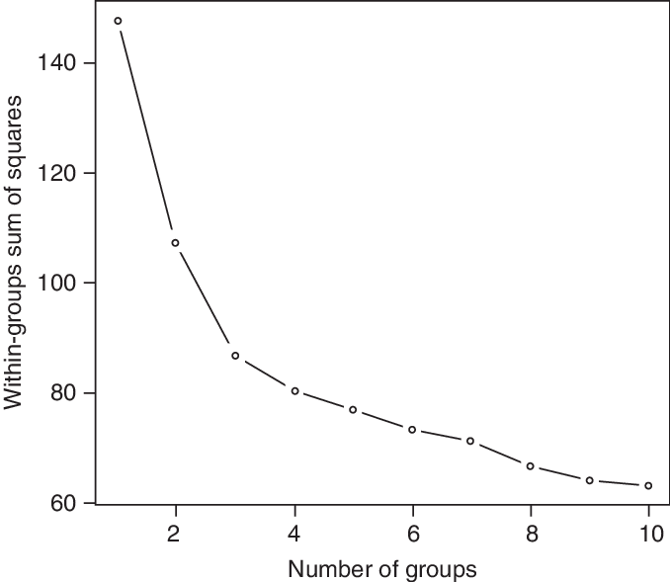
Practice Questions
Comparing K-means and Agglomerative Clustering
Which has better computational complexity?
Which has more hyperparameters?
Based on the graph, what number of clusters k is most optimal?

